Slide 1

Routing Protocols in Cloud Computing
Ankita Wankhede
ID - 16233344
Advanced Operating Systems
Dept. of Computer Science
School of Computing and Engineering
University of Missouri – Kansas City

Slide 2
AGENDA
Abstract
Introduction
Literature Review
Comparative Analysis
Future Work
Conclusion
References

Slide 3
Abstract
Cloud Computing is the way forward for the IT infrastructure
Multiple Routing Protocols have been studied and evolved over the years
Compare multiple routing protocol
Evaluated which are the best routing protocol for cloud
Need for a new Routing protocol.

Slide 4
Introduction
What is Cloud Computing?
It is technology that uses internet, central remote server to maintain a data & application.
Used to store the data on remote server securely and retrieved it.
Ex. Yahoo, Gmail, Hotmail, etc
What is Routing Protocol ?
A routing protocol specifies how routers communicate with each other, disseminating information that enables them to select routes between any two nodes on a computer network.
Each router has a priori knowledge only of networks attached to it directly.

Slide 5
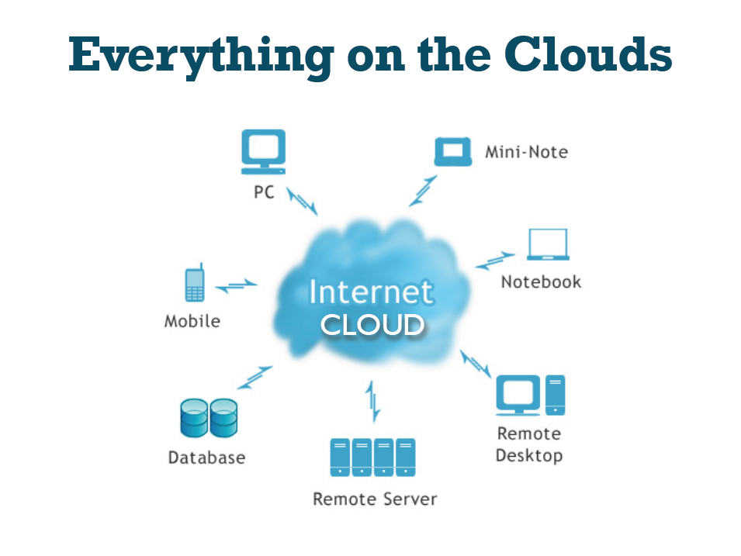
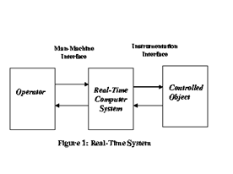
Cont..
In real time operating systems, the jobs are executed based on the availability of resources on that computer. For an efficient process scheduling we should consider the below points.
a. Should meet the time constraints of the system.
b. Should prevent simultaneous access to shared resources.
c. Should attain high degree of utilization with time constraints into consideration.
d. Need to reduce the context switching due to preemption.
e. Reduce the communication cost in the Real-time systems.

Slide 6
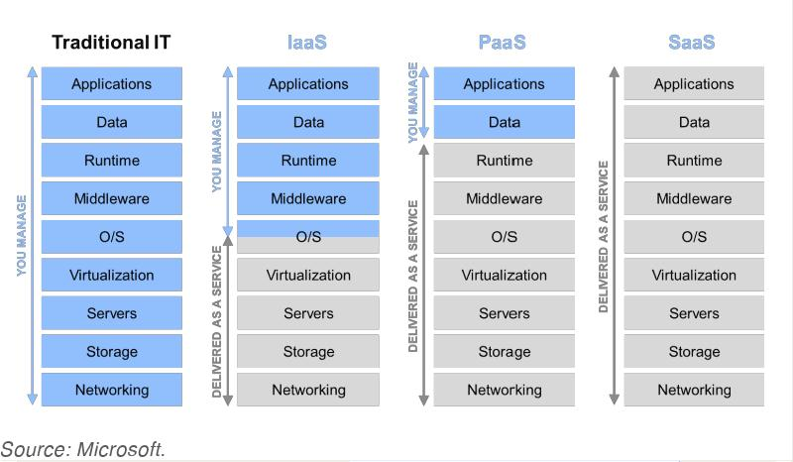
Cloud Service models - Comparison

Slide 7











Cloud Service models - Examples
Software as a Service (SaaS)
Platform as a Service (PaaS)
Infrastructure as a Service (IaaS)

Slide 8
Literature Review
There are 3 types Routing Algorithms and Protocols for Cloud Computing that are discussed in the paper.
Proactive
Reactive
Hybrid
There are no one solution for all when it comes to routing, a lot of thought needs to go in what kind of a network is getting set up .
How is it going to be used, is based on multiple factor, one can decide what is the best routing protocol that can fulfill the needs of its cloud environment.

Slide 9
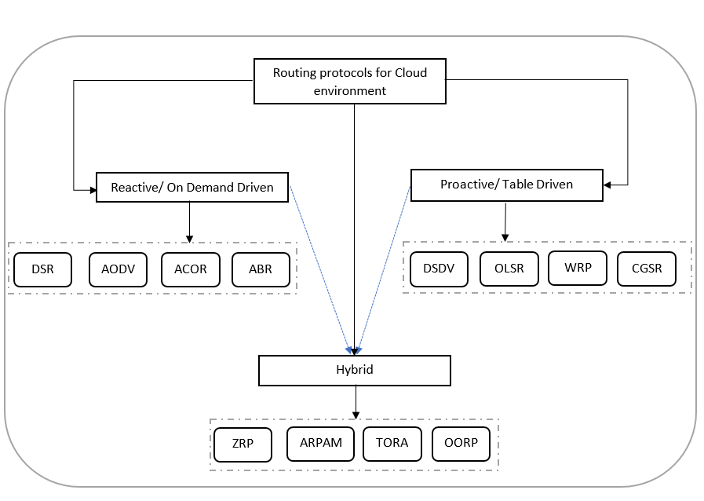
Literature Review
DSDV - Dynamic destination – Sequenced distance vector
OLSR - Optimized Link State Routing
WRP – Wireless Routing protocol
AODV - Ad hoc On-demand Distance Vector
DSR - Dynamic Source Routing Protocol
ABR – Associativity based routing protocol
ZRP – Zone routing protocol.

Slide 10
Literature Review
Proactive Protocol(2012 paper)
1.Dynamic destination – Sequenced distance vector(DSDV)
It is a table-driven routing scheme for ad hoc mobile networks.
The main contribution of the algorithm was to solve the routing loop problem.
Each entry in the routing table contains a sequence number, the sequence numbers are generally even if a link is present; else, an odd number is used.
Advantages and Disadvantages
Faster and efficient transmitting of packets, since information regarding all nodes is already available in the table.
Since the tables are constantly updated, the routing path for protocol gets pre defined, thus making alternatives unavailable..

Slide 11
Literature Review
Proactive Protocol(2016 paper)
2.Optimized Link State Routing (OLSR)
It is protocol that can effectively work on different networks.
The protocol is based on two primary concepts, one detecting its neighbor and selecting a set of nodes that will be used for transferring packets.
Second is avoids flooding of the network and provides the shortest path using which the information can be relayed.
Advantages and Disadvantages
Since not all the nodes are used, it helps manage energy efficiently and help transfer data with minimum hops.
It is more time consuming to discover an alternate path since it does not store information of all the nodes.

Slide 12
Literature Review
Proactive Protocol(2011 paper)
3. Wireless Routing protocol (WRP)
One of the best feature of the protocol is that it helps avoid looping by using serialization.
Each node can itself monitor whether it needs to update its tables based on information from its neighbor nodes
Advantages and Disadvantages
Provided routing are loop free.
Not scalable on large networks

Slide 13
Literature Review
Reactive Protocols(2012 paper)
Ad hoc On-demand Distance Vector (AODV)
AODV is the routing protocol used in ZigBee - a low power, low data rate wireless ad hoc network.
In AODV, is an on-demand routing protocol which sets up the connection between source and destination nodes when a request to transmit packets is received between them.
There are various implementations of AODV such as MAD-HOC, Kernel-AODV, AODV-UU, AODV-UCSB and AODV-UIUC.
Advantages and Disadvantages
Connection are established based on the request, On-demand.
Too much time is required for processing.

Slide 14
Literature Review
Reactive Protocols(2013 paper)
2. Dynamic Source Routing Protocol (DSR)
DSR is another example of reactive protocol, however the protocol relies on two processes to setup routing in the network.
1. Route Discovery
2. Route maintenance
It helps in detecting failures early and take the necessary action.
Advantages and Disadvantages
It becomes fast and easy to use alternative routes in case of failures.
Network may get flooded as the request for routes may be received by all nodes in the network.

Slide 15
Literature Review
Hybrid Protocol(2013 paper)
1. Zone Routing Protocol (ZRP)
ZRP is a hybrid Wireless Networking routing protocol that uses both proactive and reactive routing protocols when sending information over the network.
ZRP was designed to speed up delivery and reduce processing overhead by selecting the most efficient type of protocol to use throughout the route.
Advantages and Disadvantages
Faster transfer occur in case the source and destinations are intra zones.
In case more number of nodes activated it is hard to be efficient.

Slide 16
Comparative Analysis
We have compared all the Routing Protocol based on few important parameters
Below are the parameters on which we have compared the protocols
Classification – Proactive, Reactive, Hybrid
Scalability– the capacity to be changed in size or scale.
Power Usage– How much energy is consumed.
Volume – how much work is performed by the resource.
Mobility– ability to move, or be flexible.
N/W Overhead– amount of time spent in communicating.
Multicasting– to send data across to more than one destination.
Loop Free- No loops are formed in the path to destination
Multiple Routes– multiple paths (shortest and alternate paths to destination)

Slide 17
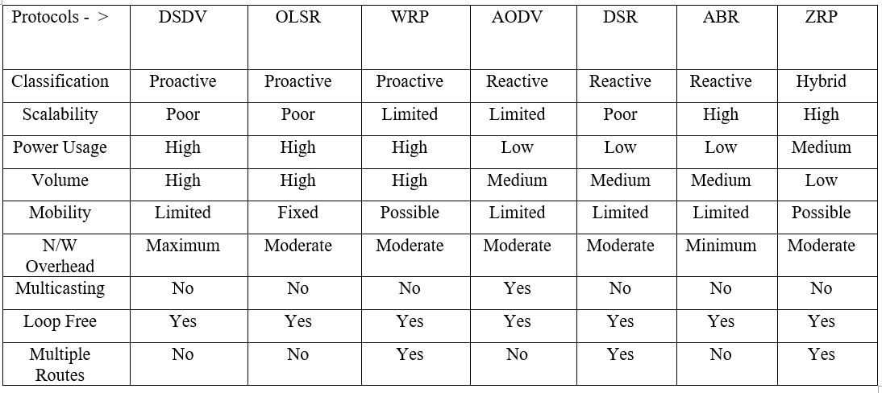
Comparison Table

Slide 18
Future Work
Cloud Computing is a huge web of network connecting multiple Data centers.
For a complex network, the routing protocol needs to be autonomous, adaptive and scalable.
One of the many research in this area is around Bio-inspired routing algorithms.
like a bacteria sniffing for food and taking its environment into consideration, this routing protocol looks for the destination taking the electro chemical changes in network in to consideration.
PGBR (Parameterized gradient based routing) is one such protocol which has shown excellent results in labs and experiments.

Slide 19
Conclusion
One solution for every problem is not possible.
Every routing protocol has its pros and cons.
Lot of decision goes into the network requirement (performance, Energy, Scalability etc.)
Most key players use multiple routing methods in their network based on their properties ex.
With the new concept of Internet of Things, much more complex designs and challenges will present it self.

Slide 20
References
[1] IBM Cloud,” IBM, 17-Oct-2016. [Online]. Available:https://www.ibm.com/cloud-computing/learn-more/what-is-cloud-computing/. [Accessed: 21-Jul-2017]
[2] L. Wang, GregorLaszewski, Marcel Kunze, Jie Tao, ―Cloud Computing: A Perspective Study‖, New Generation ComputingAdvances of Distributed Information Processing, pp. 137-146, vol. 28, no. 2, 2008.
[3] G. D. Libero, “Cloud Computing Archives,” Marketing Technology Brief. [Online]. Available: http://www.marketingtechnologybrief.com/tag/cloud-computing/. [Accessed: 21-Jul-2017].
[4] W. Voorsluys, J. Broberg, and R. Buyya, "Introduction to cloud
computing," Cloud Computing, pp. 1-41, 2011.
[5]2017.[Online].Available: https://www.dialogic.com/~/media/products/docs/whitepapers/12023-cloud-computing-wp.pdf. [Accessed: 21- Jul- 2017].
[6] International Journal of Advanced Research in Computer and Communication Engineering Vol. 4, Issue 5, May 2015
[7] G. Jose Moses, D. Sunil Kumar Prof.P. Suresh Varma N. Supriya, “A Simulation Based Study of AODV, DSR, DSDV Routing Protocols in MANET Using NS-2”, in International Journal of Advanced Research in Computer Science and Software Engineering Volume 2, Issue 3, March 2012; Publication Year: 2012.
[8]A. Khapre and U. Lilhore, "MET OLSR – An Energy Effective OLSR based Routing Protocol", International Journal of Computer Applications, vol. 146, no. 13, pp. 1-4, 2016.
G. RAJKUMAR, DR. K. DURAISAMY, “A Review of Ad Hoc On-Demand Distance Vector Routing Protocol for Mobile Ad Hoc Networks”, in Journal of Theoretical and Applied Information Technology, Vol. 36 No.1, 15th February 2012, Publication Year: 2012.
[11]V.RAJESHKUMAR,P.SIVAKUMAR, “Comparative Study of AODV, DSDV and DSR Routing Protocols in MANET Using Network Simulator-2”, International Journal of Advanced Research in Computer and Communication Engineering Vol. 2, Issue 12, December 2013; Publication Year: 2013.
[14] S. Balasubramaniam, J. Mineraud, P. Mcdonagh, P. Perry, L. Murphy, W. Donnelly, and D. Botvich. An Evaluation of Parameterized Gradient Based Routing with QoE Monitoring for Multiple IPTV Providers. IEEE Transactions on Broadcasting, 57(2):183–194, 2011.

Slide 21

Thank you!

